Slide 1

All on board: Building organisational CAPACITY TO capture the IMPACT of INFLUENCE
AES conference
September 2011
Jennifer Davis & Annie Pettitt
Australian Human Rights Commission
Marg Scott WestWood Spice
Notes:
Acknowledge traditional owners of the land we are meeting on.

Slide 2

Background
What are human rights?
Laws and systems/UN International/national treaties & covenants
Principles and ideals
What are we?
National Human Rights Institution-Independent statutory
Public service agency
Approx. 120 staff
How we work?
Influencing national agendas
Building human rights into Australian policy, law & practice
Resolving discrimination & human rights complaints
Monitoring and reporting
Engaging internationally
.

Slide 3
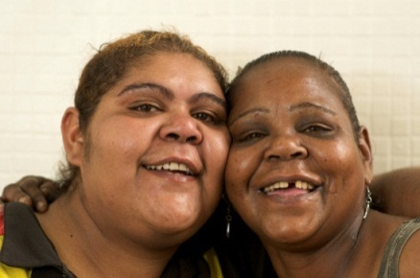
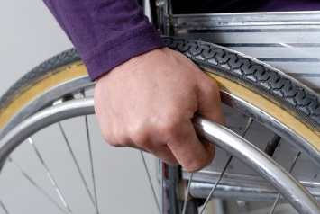
Aim: ↑ Ability to articulate our contribution to
improved human rights
Objectives:
Positive M&E culture change
↑ systems & processes enabling M&E
↑ knowledge & skills of staff
↑confidence of staff to implement M&E.
↑ implementation of M&E
↑ ability to demonstrate impact towards strategic goals

Slide 4
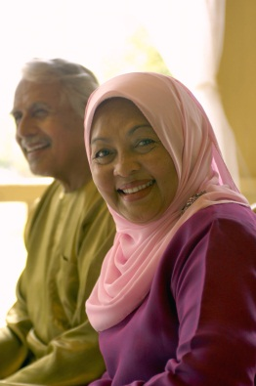
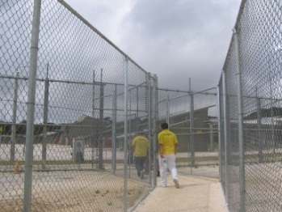
Context
Contemporary public sector accountability
International human rights systems & guidelines
2008 – Commission’s 21st year event identified evaluation issues.
2009 – restructure → centralised SPPT team with change mandate.
2010 - 8 policy teams under 1 senior Director
Baseline staff survey results

Slide 5
Our model
Three strategic areas of positive change: capability, systems, culture.
Action research model with 3 key elements
  leadership from multiple levels
  sustained presence of the critical-friend
  embedding of systems & planning processes
  Extended time frame
  Modelling - walking the talk

Slide 6
Change theories & approaches
Diffusion of innovation
Stages of change : trans-theoretical framework
And
Multi-disciplinary Evaluation Capacity Building
Participatory, experiential, immersion learning.
Funnell & Rogers 2011, Garcia-Iriarte et al 2011, Suarez-Herrera 2009, Preskill & Boyle 2008, Green at al 2008, Beere 2005, McDonald et al 2003, Prochaska & DiClemente 1983
Notes:
Underlying theory of change
applying diffusion theory (where an innovation or idea develops in a source area and remains strong there, while also spreading outward to other areas),

Slide 7
Project outcome
data is captured
Commission is
seen as an
evaluating organisation
Effective projects can
be identified
Evaluation plans
are routinely evident
Common M&E
terms & approaches
the Commission
↑staff confidence
& experience
User friendly
tools available &used
M&E framework in
place & operational.
Compelling evidence
Of contribution to
human rights
M&E planning &
implementation
systems developed
Staff are involved
in testing M&E
tools & systems
Staff are aware of &
using them
↑staff M&E
understanding & skills
Influence of the
critical friend
model is demonstrated
Common M&E
Language is in place
Toolkit reflects staff
needs and is valued
Logic model
Leadership
Exposure to external
expertise.
Mentoring, technical
advice
Participatory,
experiential learning
Critical review &
reflective learning
Modelling
M&E prioritisation
in planning
Technical advice
CF mentorship
Training &
workshops
Common terms
M&E tools &
systems
M&E Framework
M&E Toolkit
Budget
Project staff
Senior staff
support
Evaluation
Critical
Friend (CF)
Champions
group
Outputs
Processes
Immediate outcomes
Intermediate outcomes
Inputs

Slide 8
Leadership : internal change agents
Director
  Executive liaison & influence
      Strategic leadership & outlook
      Authority
      SPPT Project staff
  Project management
      Capacity & capability
      Energy, enthusiasm, excitement.
Champions group
  Staff member from each team
  Two way team conduit
  Views & voice
  Engagement

Slide 9
External change agent: critical friend
Credibility & independence
Technical expertise & advice
Coaching, training, tailored workshops
Mentoring [SPPT project lead staff]
Relationship – complex & multifaceted
  Mediation…safety-net…brokerage…and more…

Slide 10
Activities to date
Champions group
16 team workshops
SPPT lead staff mentoring sessions
Regular planning & review [AR]
2 ‘basics’ training sessions
Assisting teams with tools, design of evaluation
Baseline & 1 year on staff surveys
New project planning system embedded
Toolbox resource
New strategic plan with M&E framework

Slide 11
Key results and achievements
New strategic plan
Growing staff enthusiasm
Lead staff development
Excellent working relationships
New systems in place
Funding extended
NT and SJ reports evaluated - first comprehensive evaluation with a team.
Positive results in survey 2

Slide 12
Challenges & road humps!
Major diversion : planning needed before evaluation possible
Expectations for tangible results
Best use of critical friend resource
Staff barriers:
Entrenched ways of thinking & working
Time issues and culture
Theory & planning fatigue
Team sub-cultures & internal politics
Capacity, capacity, capacity

Slide 13
Critical friend perspective
Multifaceted role
  balancing/juggling
  soothing
  critique-ing
  advising
  Advocating
  encouraging
  and much more…………………………

Slide 14

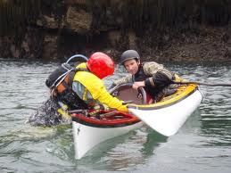


Slide 15
Evidence of change: Staff survey
Baseline & 1 year on (60%)
Rich qualitative data & quantitative data
Positive shift? Yes [with limitations]
  Knowledge? 2010 (10%) 2011 (46%)
  Confidence? 2010 (14%) 2011 (30%)
  Strength of Culture? 2010 (14%) 2011 (25%)

Slide 16
Leadership from multiple elements
“Leadership from teams and cross-staff groups,
and leadership from [ref to SPPT], in particular”.

Slide 17
Sustained presence of the critical-friend
“I feel the project has been incredibly helpful.
I would not have been able to design the evaluation plan for my current
project without the mentorship of [critical friend]”

Slide 18
  Embedding of systems & planning processes
“Definitely the integration of evaluation into the new systems and planning processes and linking the Strategic Plan to the M+E framework”.

Slide 19
Culture change?
“The culture of evaluation in the Commission is taking root”.

Slide 20
Capability change?
…putting the theory into practice has been an excellent way to further develop and modify my evaluation practices.

Slide 21
But not all are aboard…
“Extra work, extra meetings”
“Sometimes I feel it is a little time consuming when I have substantive work to do”.

Slide 22
It works: takeaways & tactics
Leadership essential
Value of critical friend role
Multifaceted approach
AR model appropriate : flexibility is vital, recognising mistakes
Importance of solid foundations: planning & project design,
Walking the talk! Modelling M&E within the initiative

Slide 23
……takeaways & tactics
Enthusiastic internal change agents
Capacity & budget is manageable
Sustained activity - 2 year process
Keeping M&E on everyone’s agenda

Slide 24
Where to next?
1 more year – maintain momentum
Organisational M&E framework & alignment with projects
More ‘partnerships’ with teams to evaluate their projects & where all learn by experience.
Meeting expectations – team evaluations
Getting past “tipping point”
Gathering substantive evidence of impact

Slide 25

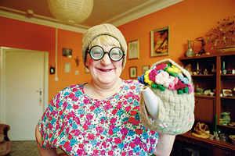

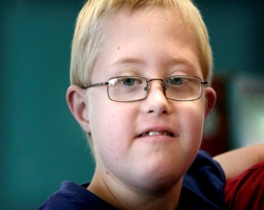
Thank you
Acknowledgments:
Darren Dick - Director Strategic Policy & Programs
Jessica Bell – Project team
More information: jennifer.davis@humanrights.gov.au
MargaretScott@westwoodspice.com.au

